Slide 1
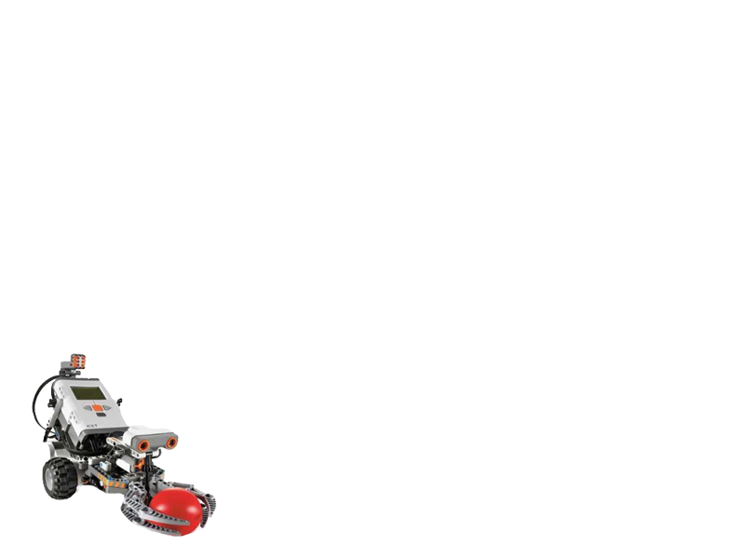
Final Year Project Lego Robot Guided by Wi-Fi (QYA2)
Presented by: Li Chun Kit (Ash)
So Hung Wai (Rex)

Slide 2
Outline
Introduction
Video Demo
System Functions > Localization > Self-Guiding > Auto Data Collection > Obstacles Detection
Conclusion
Q&A

Slide 3
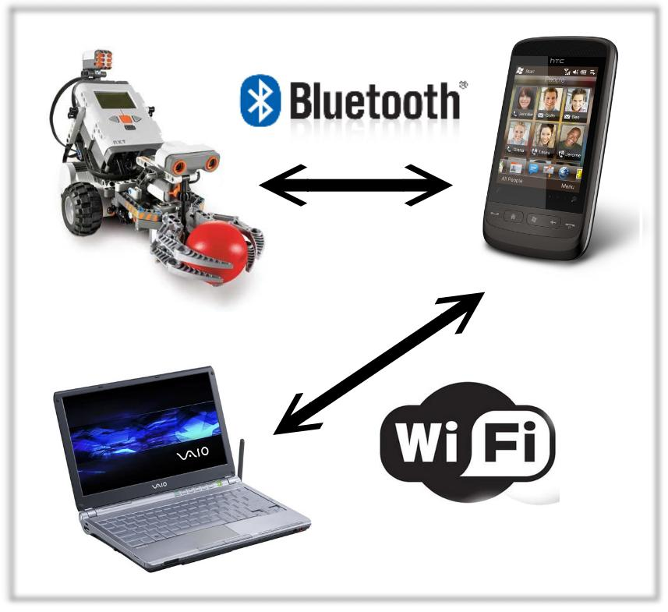
Introduction
Aims
Wi-Fi Indoor localization
Self-Guiding
Lego robot as the media
to move and collect data
automatically

Slide 4
Video Demo

Slide 5
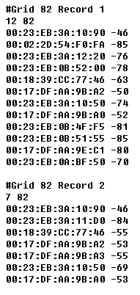
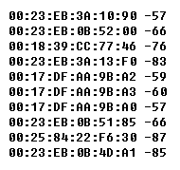
Localization
Offline Phrase | Online Phrase
Data collected for establishing the training database | Data collected is compared with the training database
Machine Learning Algorithm
Estimated Location

Slide 6
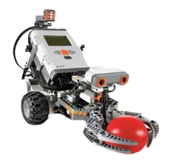
Localization : K-Nearest Neighbor (KNN)
KNN classified an unknown class object by comparing the similarity of the unknown object to the existing classified objects.
The similarity is computed using Euclidean Distance :
Distance =
K=10
K=4
Example of KNN Classification. There are three kind of classified objects.
Euclidean Distance
Records in Different Grid Cell

Slide 7
Localization: Bayesian Probability

Slide 8
Algorithm Accuracy

